Slide 1
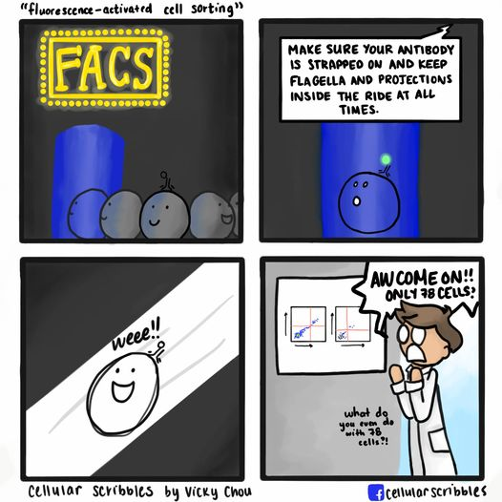
Cell sorting
Presenter: Kerishnee Naicker
Cytometry Microscopy to Omics Facility
231 Edward R. Madigan Laboratory
CMtO-Core@mx.uillinois.edu

Slide 2
Contents
Introduction to cell sorting
Cell sorting principle
Different types of sorting
Sorters available at CMtO
Preparation for sorting
Sorting on the BD FACS Melody
What do you need to know before sorting?

Slide 3
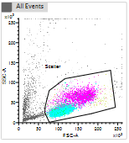
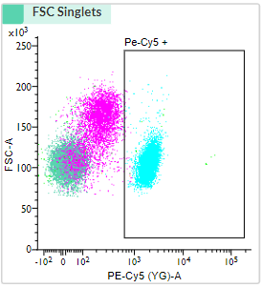
Introduction to cell sorting
Used to collect cells of interest from the rest of the population for downstream processing.
Setting up an experiment – Determine the population of interest
Selecting your sorting gates
Sorting your sample

Slide 4
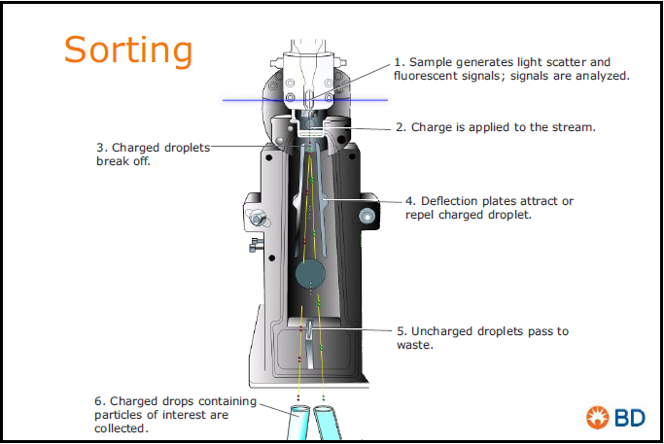
Cell Sorting principle
An electric charge is assigned to each of the particles of interest
Four-to-six-way sorters have different orders of magnitude of charge that is assigned to each of them.
Different types of sorts can be done yield, purity, single cell and index sorts
Figure 1: Principle of cell sorting (Bd biosciences,2019)

Slide 5
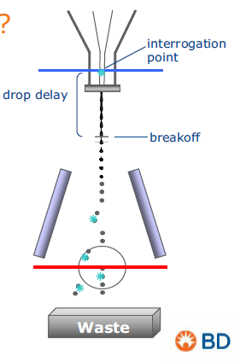
Streams, droplet formation and drop delay

Slide 6
Sorting previews
2-way sort
4-way sort
6-way sort
+
-
+
+
-
-
+
+
=
-
=
+
-
+
+
+
=
-
=
+
+
-
-
+
-
+
=
-
-
+
-
+
+
-
=
+
=
=
Tube 1
Tube 2
Tube 1
Tube 2
Tube 3
Tube 4
Tube 1
Tube 2
Tube 3
Tube 4
Tube 5
Tube 6
WASTE
WASTE
WASTE

Slide 7
Different types of sorting
Yield sorts 2. Purity sorts 3. Single cell sorts 4. Index sorting
Neg
Neg
Neg
Neg
Pos
Pos
Pos
Pos
Neg
Pos
Neg
Neg
Pos
Pos
Pos
Pos

Slide 8
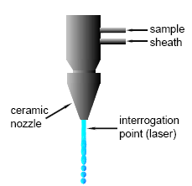
QUARTZ CUVETTE VS JET IN AIR FLOW CELL
Quartz cuvette flow cell
Jet-in air flow cell
Slower sorting rate
Cuvette NA = 1.2
More sensitive – more photons reach the detector
Faster sorting rate
NA = 0.95
Less sensitive – less photons reach the detector
https://flowbook.denovosoftware.com/chapter-2-flow-cytometer

Slide 9
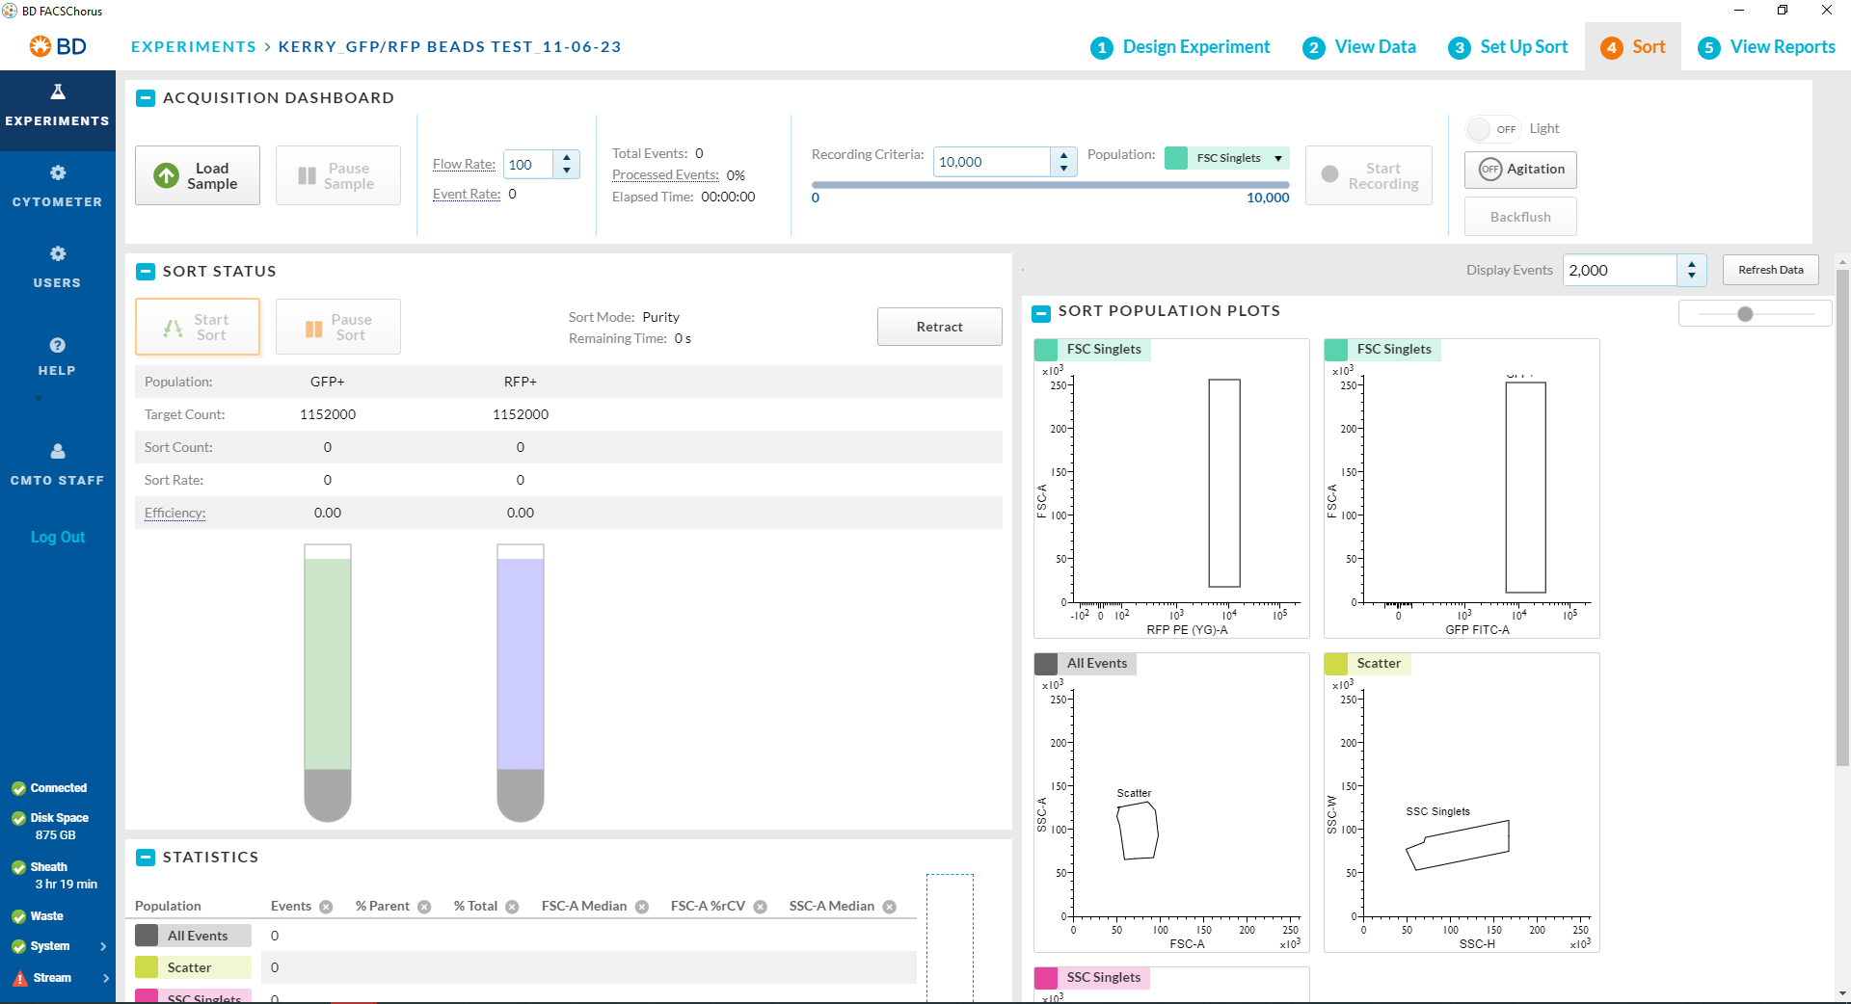
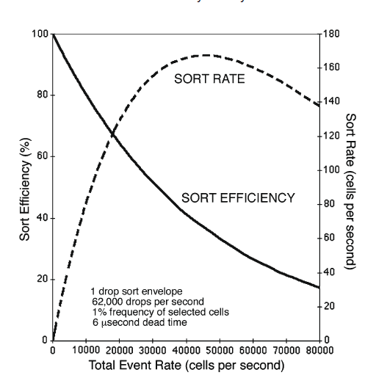
SORTING ON BD FACS Melody
Notes:
Sort efficiency graph is an animation

Slide 10
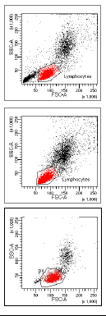
Things to keep in mind
Threshold: Keep the threshold at the recommended amount depending on the sample
Low threshold = more events of debris shown – low efficiency and high abort count
High threshold = less events shown – increases the efficiency BUT compromises the purity of the sample
PMT Voltages: Keep the PMT Voltages the same if comparing each sample
Make sure your highest intensity is on scale
Figure 3: Threshold and PMT Voltages (BDbiosciences, 2019)

Slide 11
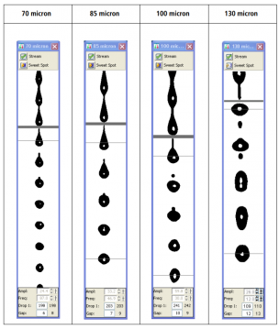
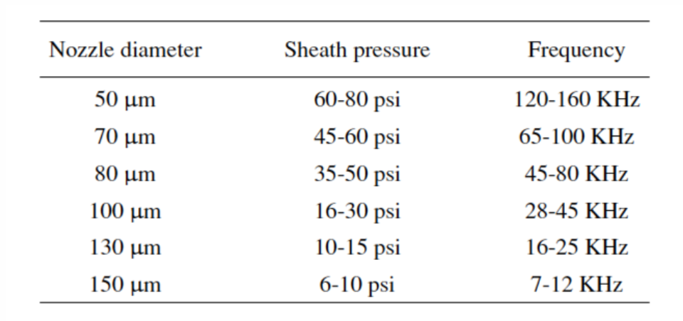
Use of different nozzle sizes?
https://expert.cheekyscientist.com/improve-flow-cytometry-cell-sorting-speed/
https://imm.medicina.ulisboa.pt/facility/flowcytometry/doku.php?id=prepare_samples

Slide 12
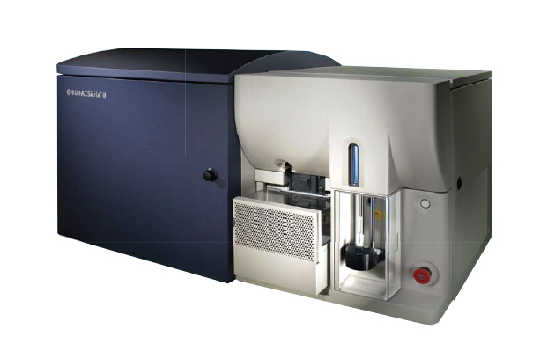
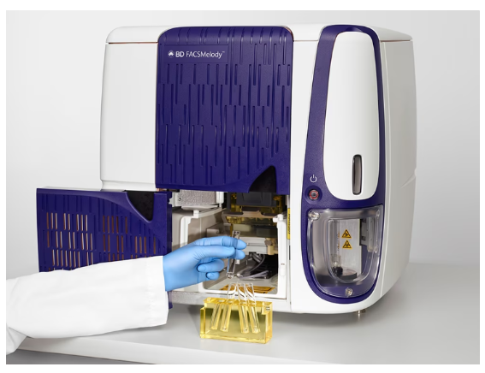
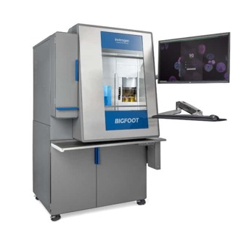
Cell sorters available at CMtO
 | BDFACS ARIA II (not in use) | BDFACS MELODY | THERMOFISHER BIGFOOT
Lasers | 4 Lasers (V, B, Y/G, R) | 3 Lasers (B, Y/G, R) | 5 Lasers (UV, V, B, Y/G, R)
Detectors | 11 | 8 | 55
Sort ways | 4-way | 4-way | 6-way
Collection tubes | 5mL polypropylene tubes, 1.5mL Eppi’s, 15mL tubes 96 well plates | 5mL polypropylene tubes, 1.5mL Eppi’s 96 well plate sorts | 5mL polypropylene tubes, 1.5mL Eppi’s, 15mL tubes, 50mL tubes 96, 384, 1536 plate sorting
Nozzle sizes | 70, 85,100um | 100um | 70, 100, 120, 150um
Sort rate | 15K per sec | 40K per sec | 70K-100K cells per sec
Temperature control | 4°C, 20°C, 37°C & 42°C | 4°C, 22°C, 37°C & 42°C | 4°C - 37°C
Flow cell | Cuvette | Quartz Cuvette | Jet and air
Website link | Aria-II | BDFACS Melody | ThermoFisher BigFoot

Slide 13
What do you need for sorting?
Collection tubes/plates and media
Single stained AND unstained control
~1 million cells per mL in each sample
Know your excitation and emission of your fluorophore/s
Test the purity of your sample after the sort
Run samples through an analyzer
Filter your samples just before sorting

Slide 14
before scheduling TO SORT AT OUR FACILITY
REQUIRED: Sort form
We would also like to learn a bit more about your project before you come in, such as:
1. What type of cells will you be bringing in?
2. Have you run these samples on an analyzer? If so, please send pdfs of your sample data.
PLEASE NOTE: THIS DATA SHOULD REPRESENT THE EXACT SAMPLES YOU WILL BE BRINGING IN FOR SORTING.
3. Are these cells BSL2? If so, is it approved by DRS?
4. What are your cells stained with (please provide the fluorophore(s) and excitations and emissions)?

Slide 15
Cancellation policy
-- No charge for appointments canceled > 48 hours in advance.
-- Appointments cancelled or changed < 48 hours but > 24 hours in advance will be billed 1/2 hour of use.
-- Appointments cancelled or changed < 24 hours in advance will be billed the whole scheduled time.
APPLIES TO BOTH ANALYZERS AND SORTERS!!

Slide 16
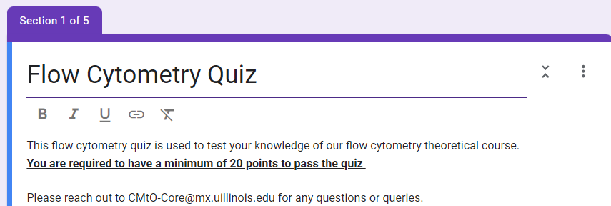
Please complete our quiz based on the theoretical training
Need to be completed if you want to gain access to the calendar and instrument.
If you already have access, you will need to complete this quiz to continue having access.

