Slide 1

Cmto
Housekeeping information

Slide 2
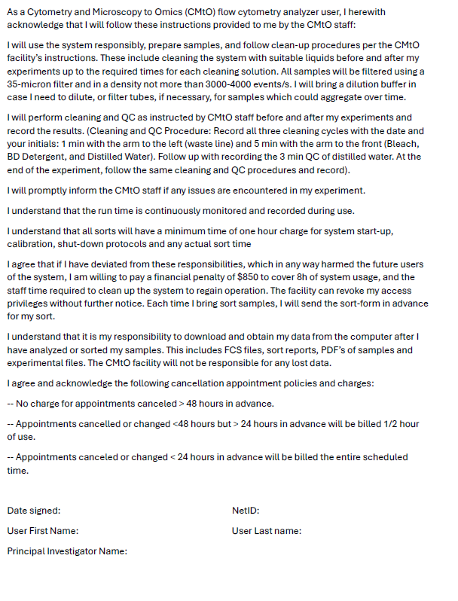
Declaration form

Slide 3
HANDS ON TRAINING POLICY:
Due to attention to the details focus needed for hands on training, it is CMtO policy that we will train only one student at a time.
However, if you have two or more students doing the same experiment from same lab, we can use same/single set of samples on that day for all of them, if we could schedule back-to-back 2h slots for the training.
Those trainings are billed for each person. Please follow this when requesting hands on training. After training in one of the Symphony A1, your account will be activated in all three Symphonies in the campus.

Slide 4
Please note: Once you are trained on any one of our 3 Symphony's, you will be granted access to all three locations. You can request access to each of our rooms with the following instructions:
Everitt Lab: Please use this link https://my.bioe.illinois.edu/login.asp?/keys/index.asp to request access to the rooms: Everitt Lab Entrance Doors (CR), and 2117 Autoclave/ Laundry and 2117 A Fortessa. Per DRS, you will require quick autoclave training before you are given access to 2117 - Autoclave Room. Wendy Woods (w-woods@illinois.edu) is responsible for that facility. Please contact her to setup a time for training.
ERML Lab: You would need to send your I-card number, NetId and UIN number to cmto-core@mx.uillinois.edu and we can request access to room 231 ERML for you. For the main door, you would need a physical key, you can email Sheena at shemar@illinois.edu. You would need to fill out a form and pay a deposit of $20.
RAL Lab: A CMtO employee will provide the door code during your training.
We also provide training on a High-Throughput System (HTS) that is housed in 2117A Everitt building, please contact cmto-core@mx.uillinois.edu for more information or training materials

Slide 5
PRICING
Analyzers
Theory training (2hrs) | $196 per person
Practical training | $98/h
Instrument time | $90/h
Sorters
Assisted sort | $219/h
Trained user (melody only) | $124/h
Sorters as an analyzer (+Assisted Use) | $90/h + $98/h
Billed in 30-minute increments
Billed in 15 minute increments
Scenario: You have a practical training for 2 hours. The total charge for this training is for the instrument time ($90x2) and for the staff time ($98x2). The total billed is $376

Slide 6
Training on the melody costs
 | Cost
Day 1 | $219/hr | 3 hrs
Day 2 | $219/hr | 3 hrs
Day 3 | $219/hr | Sort time
Day 4 | $219/hr | Sort time
After Training | $124/hr
All sorts will have a minimum time of one hour charge for system start-up, calibration, shut-down protocols and any actual sort time
Please note that any staff assistance needed for QC, cleans and shut down or instrument clogs will be charged as an assisted sort for the time spent on the instrument. This is also applicable to all users that have been trained on the melody.

Slide 7
Cancellation policy
-- No charge for appointments canceled > 48 hours in advance.
-- Appointments cancelled or changed < 48 hours but > 24 hours in advance will be billed 1/2 hour of use.
-- Appointments cancelled or changed < 24 hours in advance will be billed the whole scheduled time.
APPLIES TO BOTH ANALYZERS AND SORTERS!!
Our Cancellation policy is applicable to all CMtO services which include practical training sessions and assisted use of all CMtO instrumentation.
Cost of the services can change at every fiscal year starting in July, 1st

Slide 8
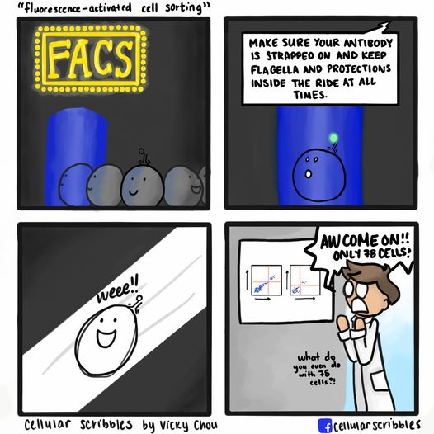
Cell sorting
Presenter: Kerishnee Naicker
Cytometry Microscopy to Omics Facility
231 Edward R. Madigan Laboratory
CMtO-Core@mx.uillinois.edu

Slide 9
Contents
Introduction to cell sorting
Cell sorting principle
Different types of sorting
Sorting on the BD FACS Melody
What do you need to know before sorting?
Differences in Flow cells
Threshold importance
Different nozzle sizes
Sorters available at CMtO

Slide 10
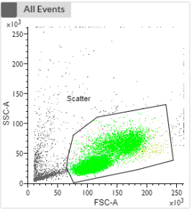
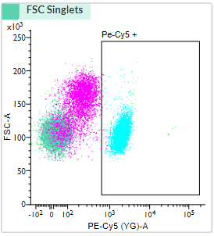
Introduction to cell sorting
Used to collect cells of interest from the rest of the population for downstream processing.
Setting up an experiment – Determine the population of interest
Selecting your sorting gates
Sorting your sample

Slide 11
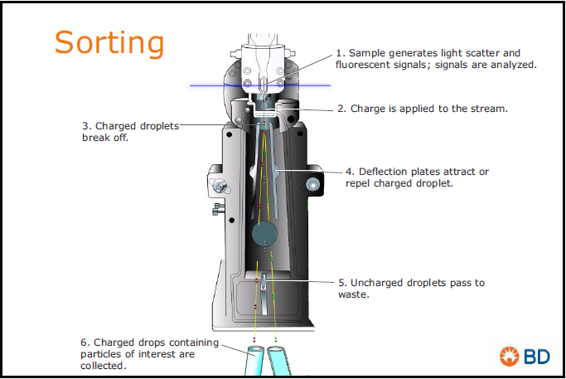
Cell Sorting principle
An electric charge is assigned to the droplet of interest (+ OR -)
This droplet is attracted to either of the deflection plates
The uncharged cells are directed directly to the waste
When you have more than 2 populations of interest, different magnitudes of + OR – charges are applied
Figure 1: Principle of cell sorting (Bd biosciences,2019)

Slide 12
Sorting previews
2-way sort
4-way sort
6-way sort
+
-
+
+
-
-
+
+
=
-
=
+
-
+
+
+
=
-
=
+
+
+
-
+
-
+
=
+
-
+
-
+
+
-
=
+
=
=
Tube 1
Tube 2
Tube 1
Tube 2
Tube 3
Tube 4
Tube 1
Tube 2
Tube 3
Tube 4
Tube 5
Tube 6
WASTE
WASTE
WASTE

Slide 13
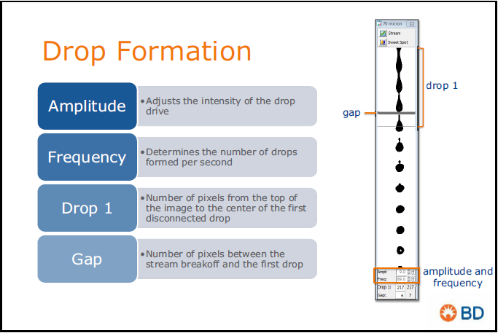
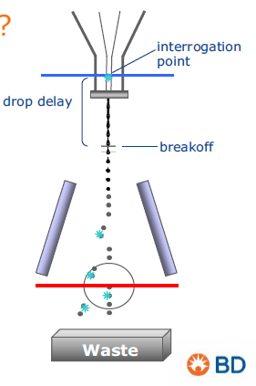



Streams, droplet formation and drop delay
(Bd biosciences,2019)

Slide 14
Different types of sorting
Yield sorts 2. Purity sorts 3. Single cell sorts 4. Index sorting
-
-
-
-
+
+
-
+
+
-
-
+
+
+
+

Slide 15
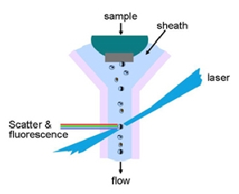
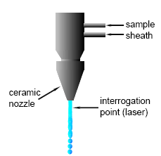
QUARTZ CUVETTE VS JET IN AIR FLOW CELL
Quartz cuvette flow cell
Jet-in air flow cell
Slower sorting rate
Cuvette NA = 1.2
More sensitive as your cells move slower through the laser beam
More photons are collected by the detector
Faster sorting rate
NA = 0.95
Less sensitive as your cells move faster through the laser beam
Less photons reach the detector
https://flowbook.denovosoftware.com/chapter-2-flow-cytometer

Slide 16
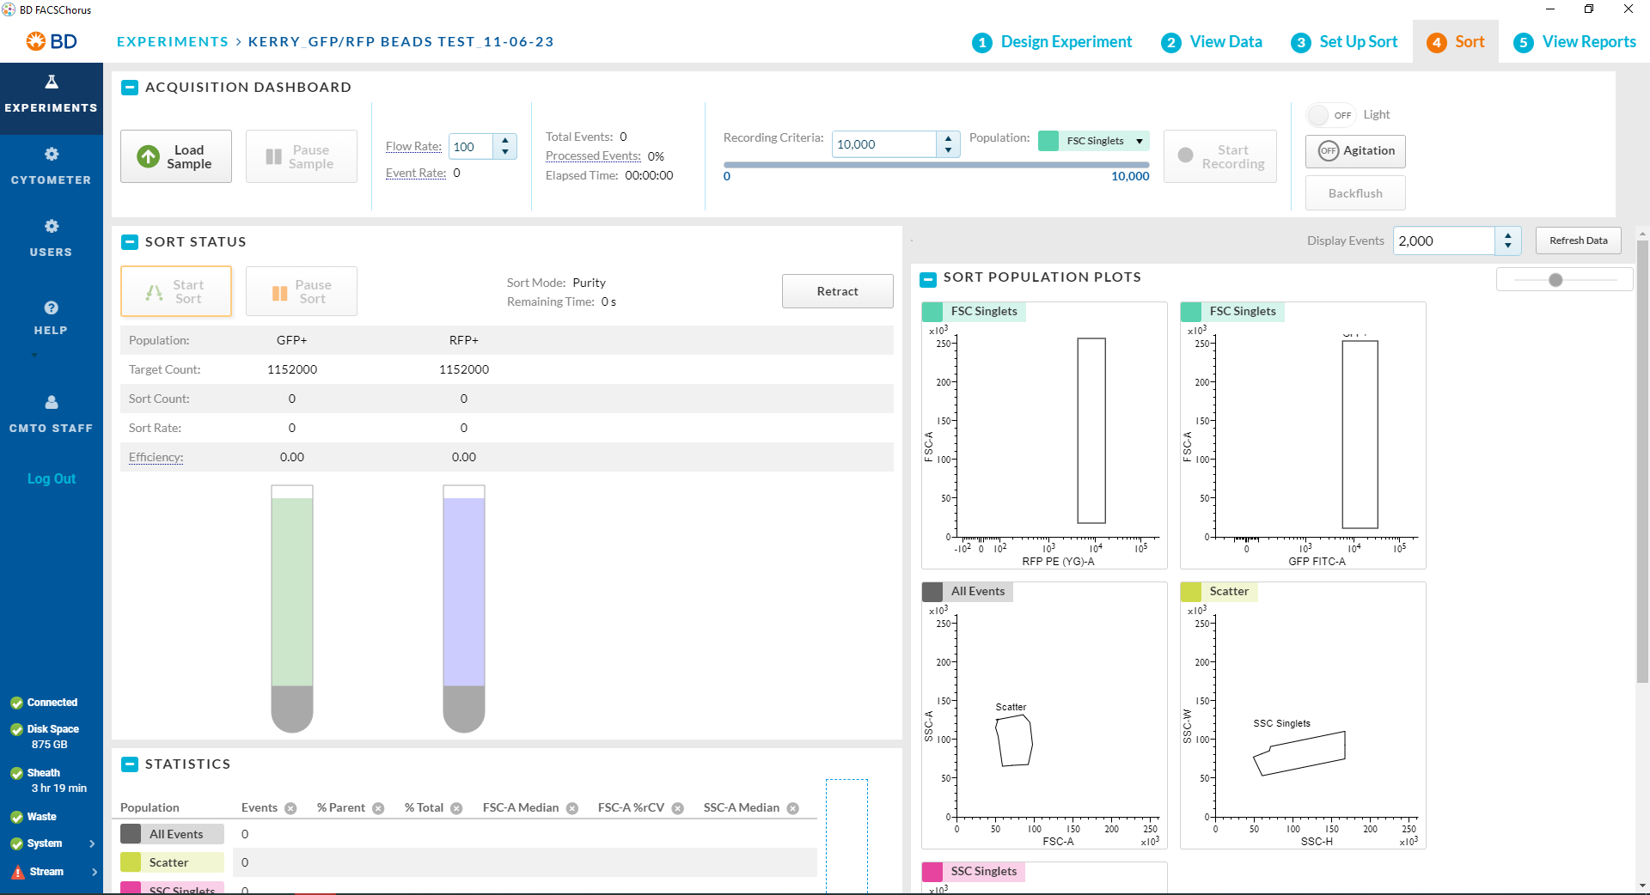
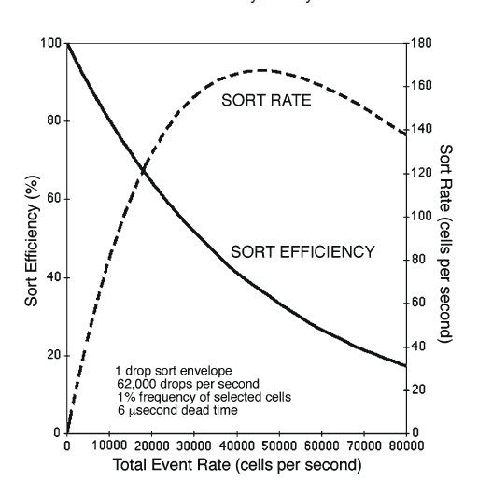
SORTING ON BD FACS Melody
Notes:
Sort efficiency graph is an animation

Slide 17
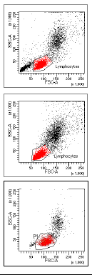


Things to keep in mind
Threshold: Keep the threshold at the recommended amount depending on the sample
  Low threshold = more events of debris shown – low efficiency and high abort count
  High threshold = less events shown – increases the efficiency BUT compromises the purity of the sample
PMT Voltages: Keep the PMT Voltages the same if comparing each sample
  Make sure your highest intensity is on scale
Figure 3: Threshold and PMT Voltages (BDbiosciences, 2019)

Slide 18
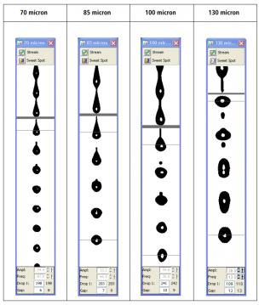
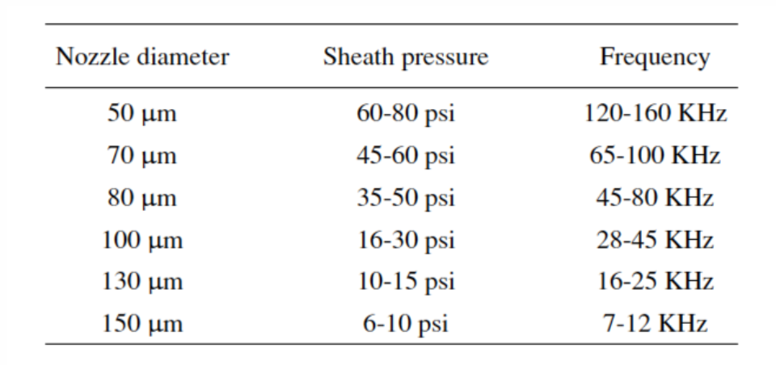
Use of different nozzle sizes?
The rule when it comes to choosing your nozzle size is that your cells MUST be 4-5 times SMALLER than the size of the nozzle
https://expert.cheekyscientist.com/improve-flow-cytometry-cell-sorting-speed/
https://imm.medicina.ulisboa.pt/facility/flowcytometry/doku.php?id=prepare_samples

Slide 19
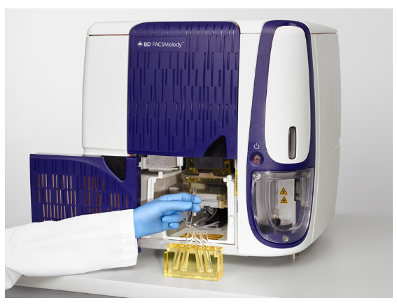
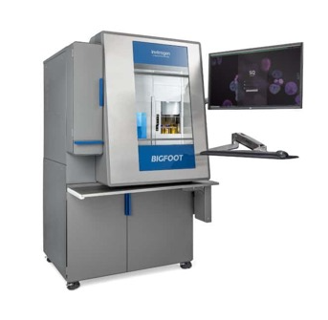
Cell sorters available at CMtO
 | BDFACS MELODY | THERMOFISHER BIGFOOT
Lasers | 3 Lasers (B, Y/G, R) | 5 Lasers (UV, V, B, Y/G, R)
Detectors | 8 | 55
Sort ways | 4-way | 6-way
Collection tubes | 5mL, 2mL, 1.5mL tubes 6, 24, 48, 96 and 384 well plate sorts | 5mL polypropylene tubes, 1.5mL Eppi’s, 15mL tubes, 50mL tubes 96, 384, 1536 plate sorting
Nozzle sizes | 100um | 70, 100, 120, 150um
Sort rate | 40K per sec | 70K-100K cells per sec
Temperature control | 4°C, 22°C, 37°C & 42°C | 4°C - 37°C
Flow cell | Quartz Cuvette | Jet and air
Training offered | Yes – 4 day training | No
Website link | BDFACS Melody | ThermoFisher BigFoot

Slide 20
Preparation for sorting and analyzing
Collection tubes/plates and media
Single stained AND unstained control
~1 million cells per mL in each sample
Know your excitation and emission of your fluorophore/s
Test the purity of your sample after the sort
Run samples through an analyzer
Filter your samples just before sorting

Slide 21
before scheduling TO SORT AT OUR FACILITY
REQUIRED: Sort form
We would also like to learn a bit more about your project before you come in, such as:
1. What type of cells will you be bringing in?
2. Have you run these samples on an analyzer? If so, please send pdfs of your sample data.
PLEASE NOTE: THIS DATA SHOULD REPRESENT THE EXACT SAMPLES YOU WILL BE BRINGING IN FOR SORTING.
3. Are these cells BSL2? If so, is it approved by DRS?
4. What are your cells stained with (please provide the fluorophore(s) and excitations and emissions)?

Slide 22

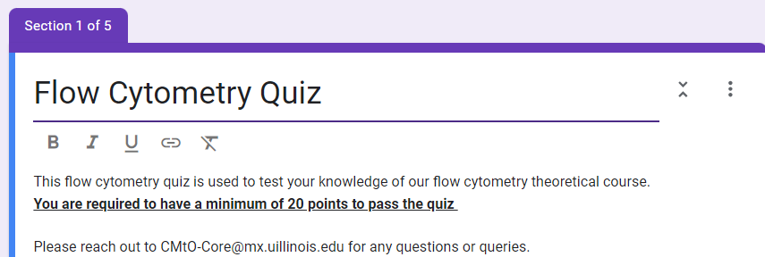
Please complete our quiz based on the theoretical training
Need to be completed if you want to gain access to the calendar and instrument.
If you already have access, you will need to complete this quiz to continue having access.

