Slide 1
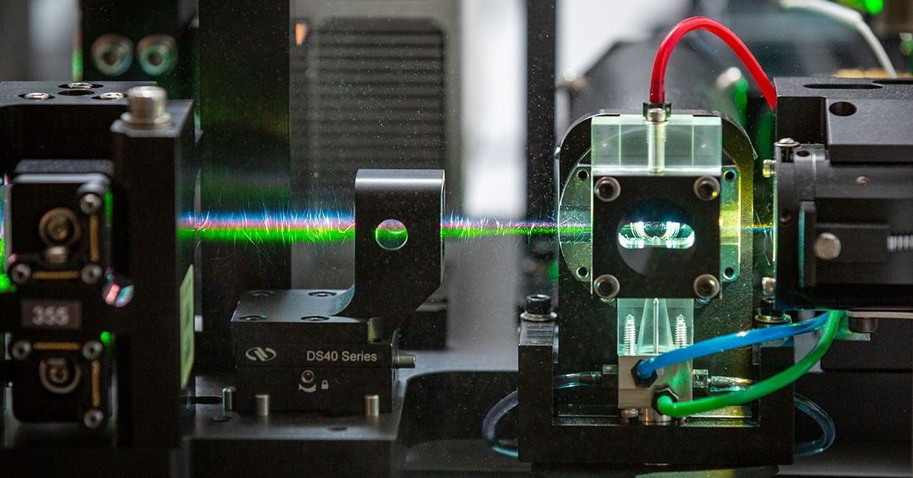
INTRODUCTION TO FLOW CYTOMETRY
Cytometry and Microscopy to Omics Facility
Carver Biotechnology Center
University of Illinois, Urbana-Champaign, 2024

Slide 2
What is a Flow Cytometry
Technology that measures properties of single cells
Measures fluorescence, light scatter, and other properties of cells and particles
Can provide correlated data that links different population profiles
If you can dissociate your samples into ‘single’ cells or particles, you can analyze them with flow cytometry.

Slide 3
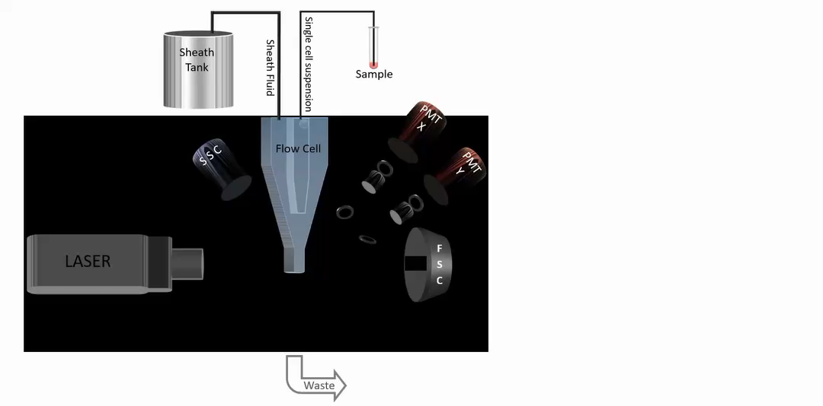
What is a Flow Cytometry
WORK-FLOW 2019

Slide 4
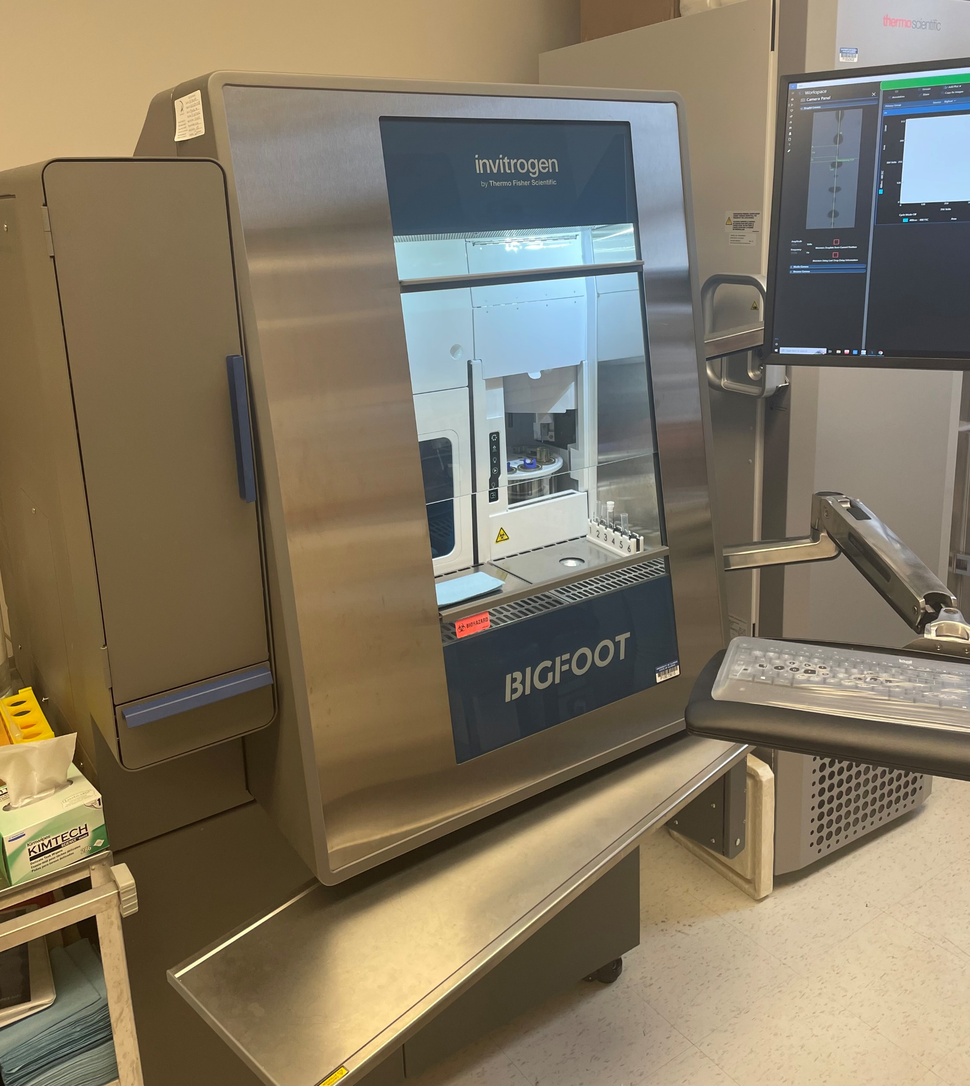
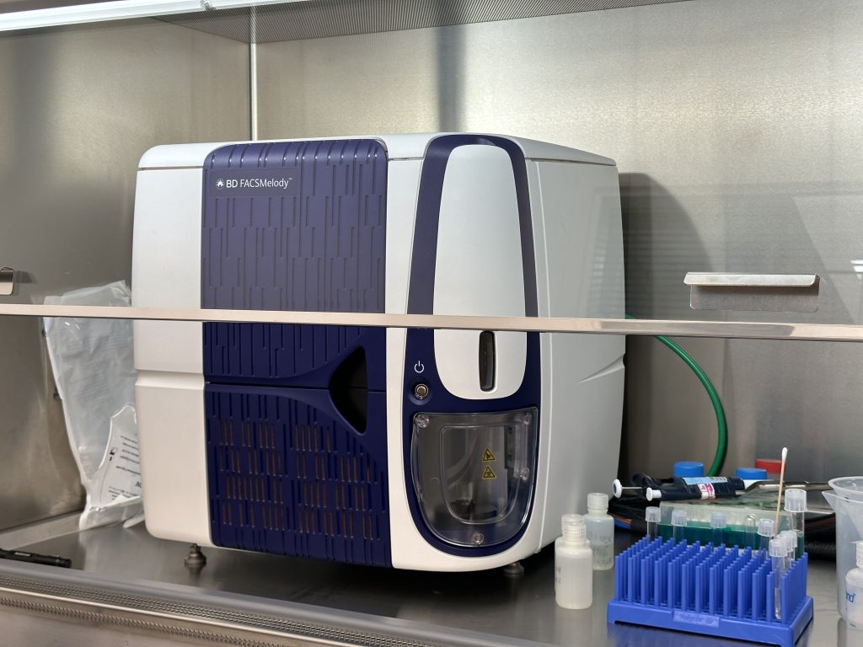
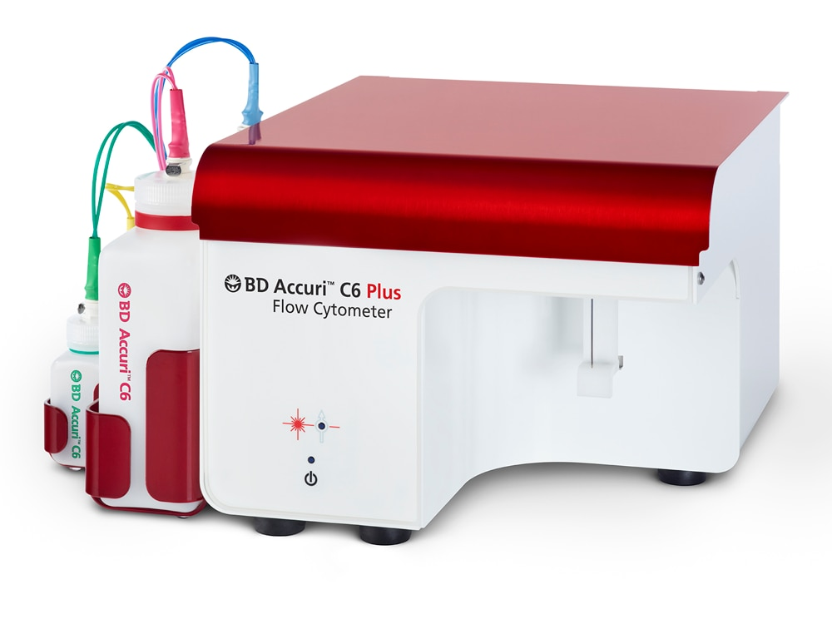
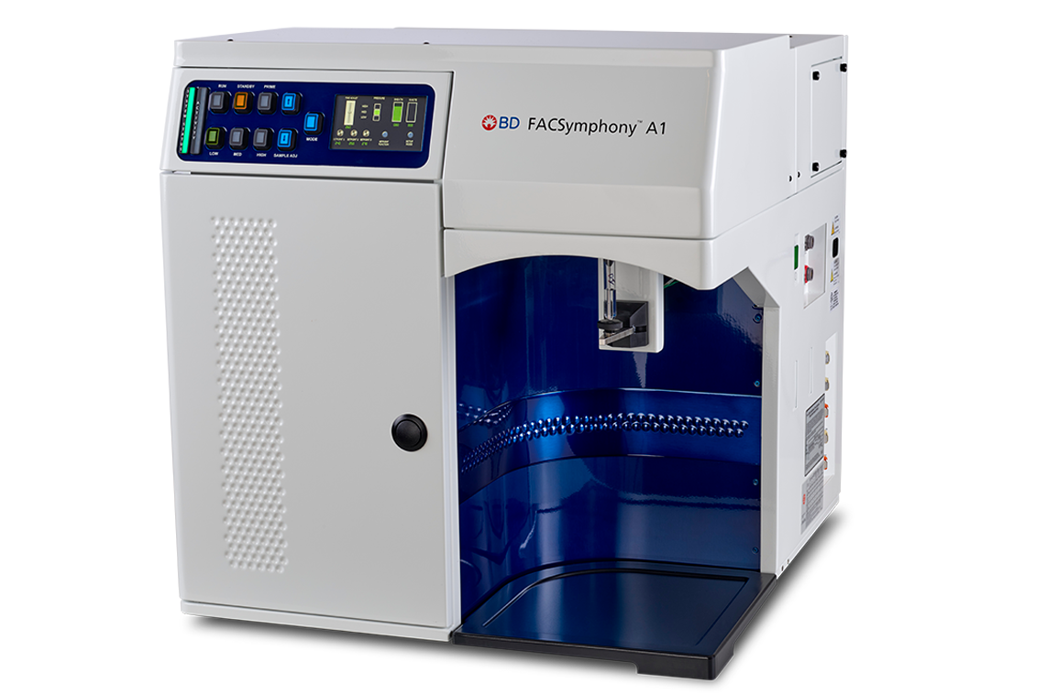
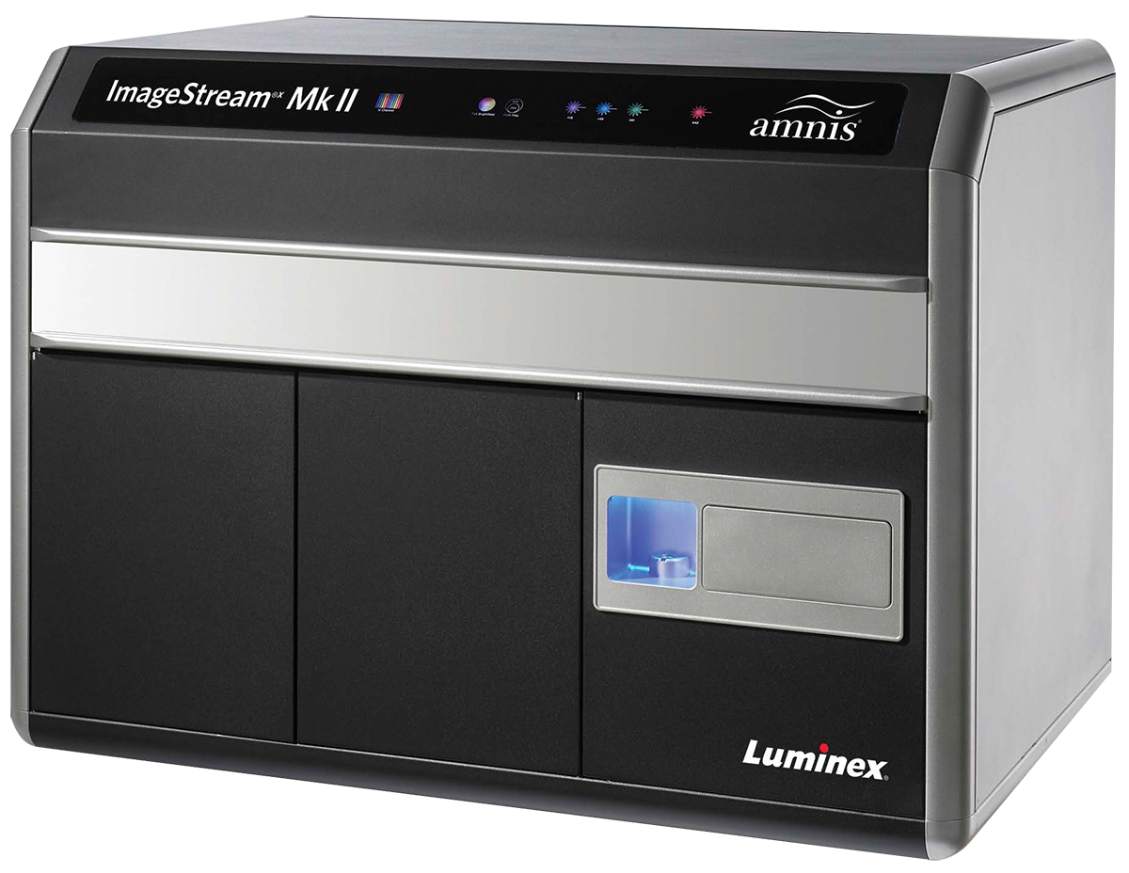
Instruments available in CMtO
Sorters:
BigFoot
BD FACS Melody
Analyzers:
x3
Accuri
BD Symphony A1
ImageStream

Slide 5
Flow Cytometry instruments
analyzer vs sorter
Flow Cytometry Analyzer
  Measuring properties of cells in flow
Flow Cytometry Sorter
  Sorting (separating) cells based on properties measured in flow
  Also called Fluorescence-Activated Cell Sorting (FACS) – this is a proprietary term from BD - this term can refer to sorting, but it is not usual to use it for analysis. FACS is thus frequently misused and likely by folks who learn flow on BD instruments. It is far better to use the term flow cytometry which is generic and covers both sorting and analysis or Cell Sorting if referring to sorting
Each cell sorter is a flow cytometry analyzer but not every analyzer is a flow cytometry sorter.

Slide 6
What are the principles?
Light scattered by a laser or other light source
Specific fluorescence detection
Hydrodynamically-focused stream of particles
Electrostatic particle separation for sorting or chip-based sorting
Multivariate data analysis capability

Slide 7
What can Flow Cytometry do?
Enumerate particles in suspension
Determine “biologicals” from “non-biologicals”
Separate “live” from “dead” particles
Evaluate 10⁵ to 5x10⁶ particles in less than 1 min
Measure particle-scatter as well as innate fluorescence or 2º fluorescence
Physically sort single particles for subsequent analysis (called Cell Sorting)

Slide 8
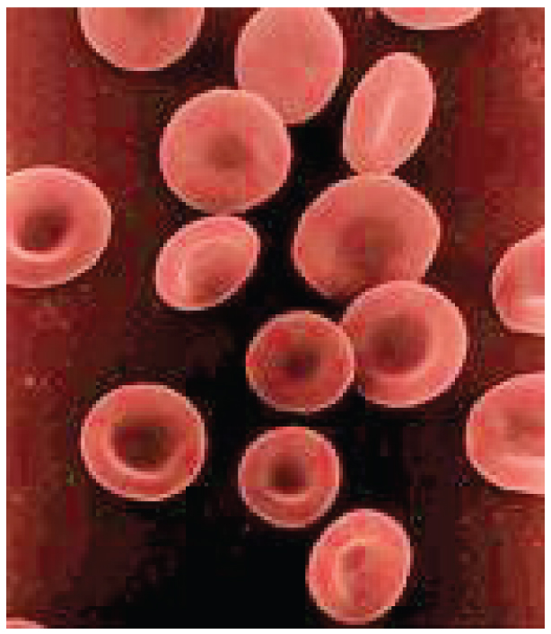
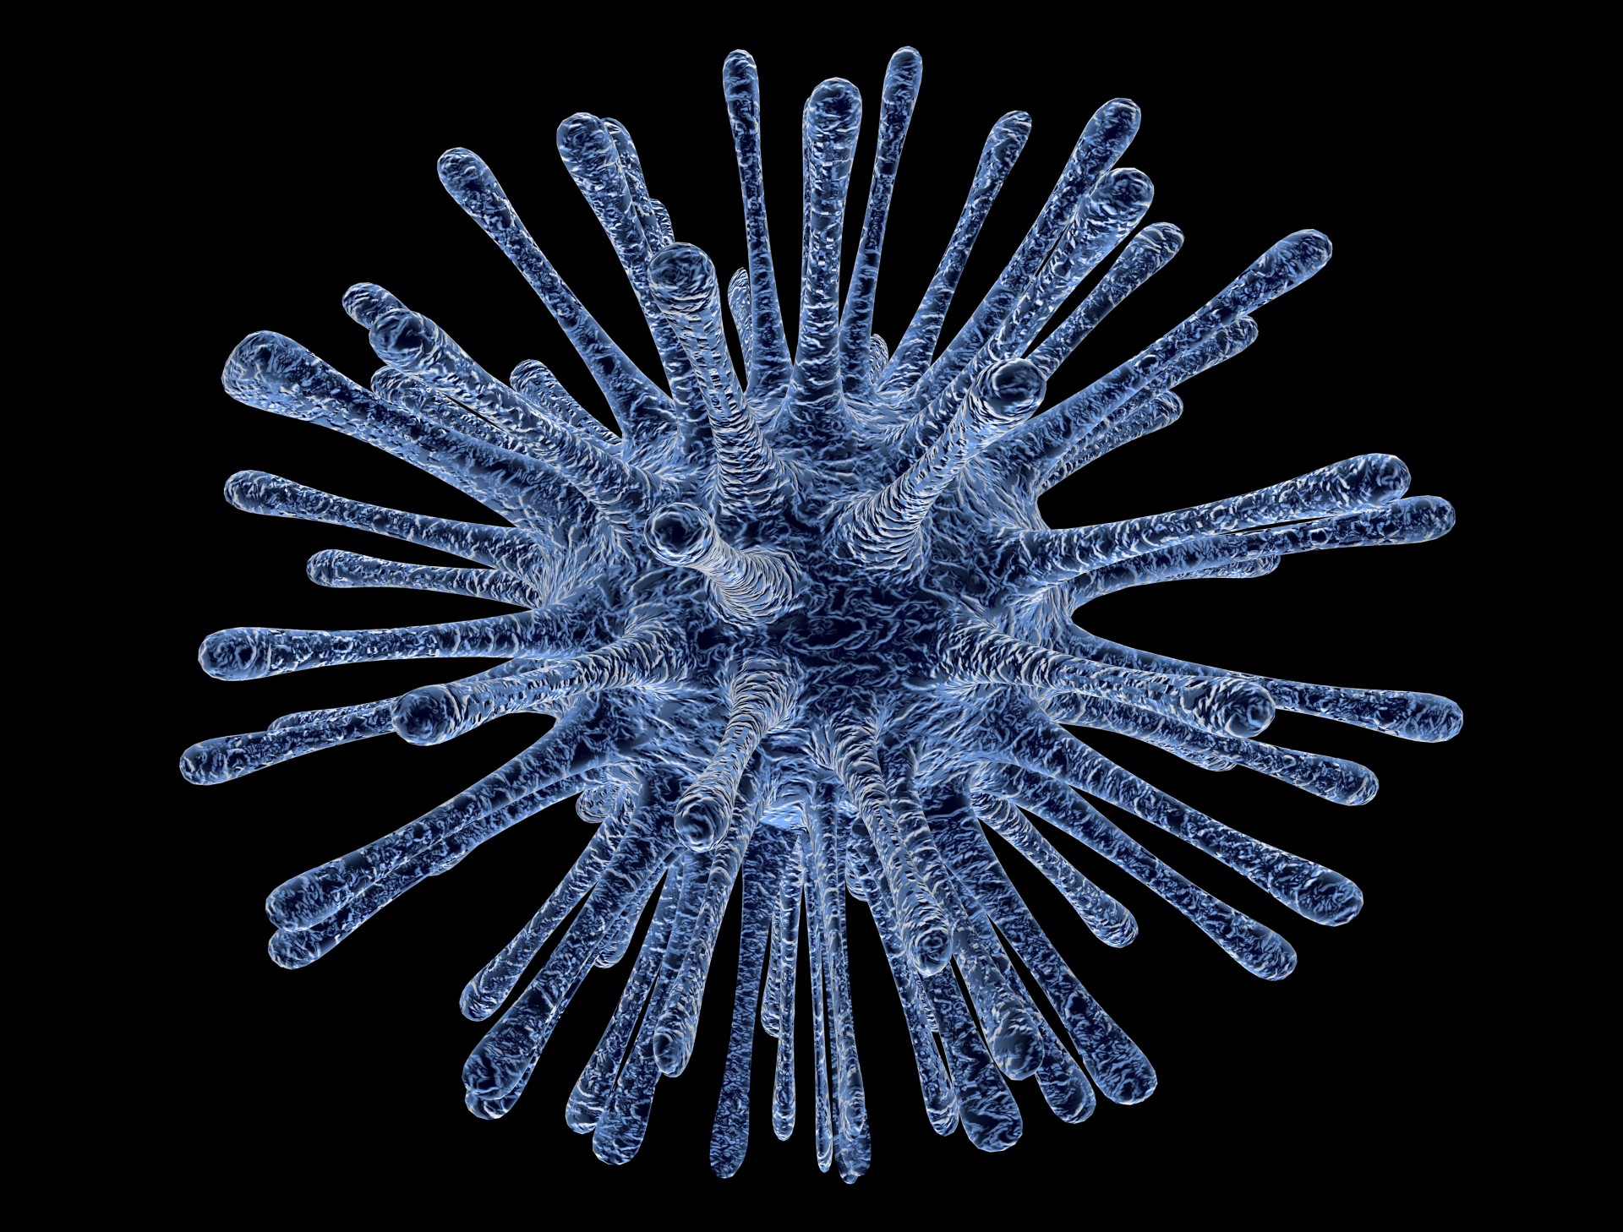
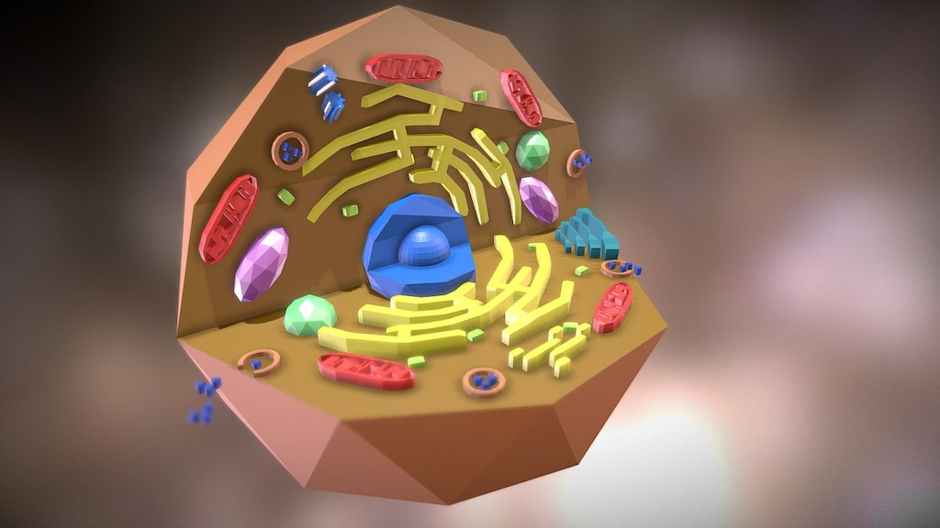
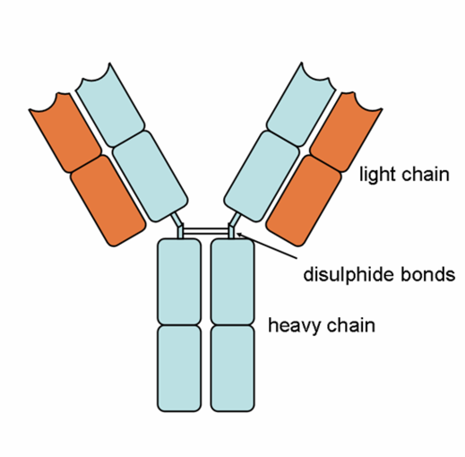
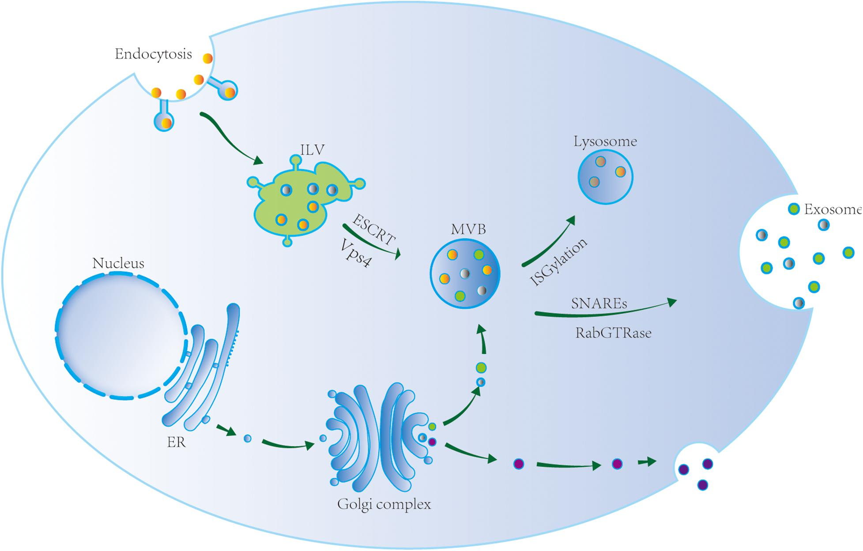
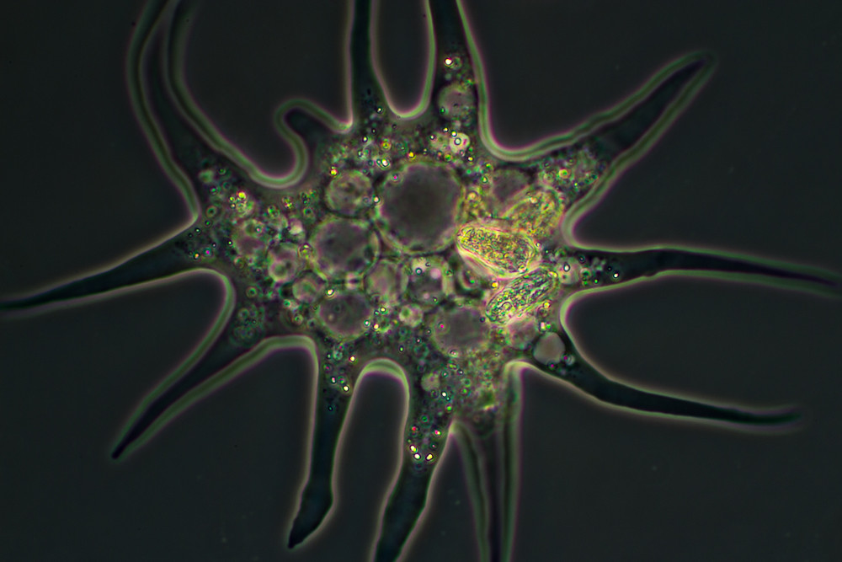
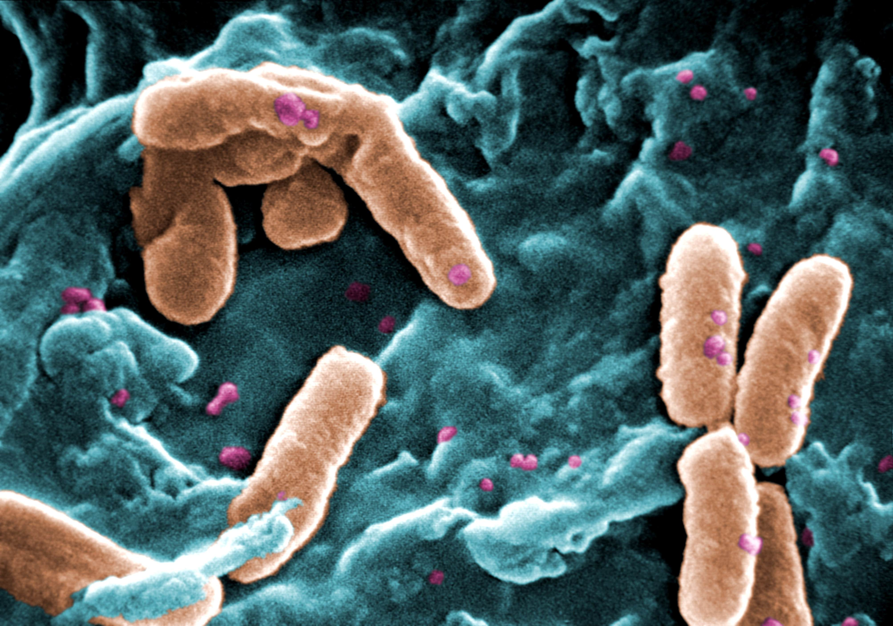
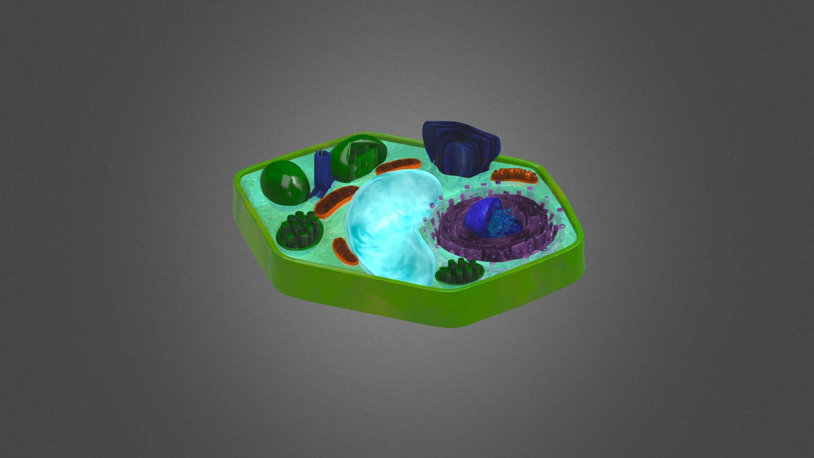
Particles analyzed by flow cytometry
most cytometers
red blood cells
mammalian cells
viruses
bacteria
antibodies
amoeba
Extracelullar
vesicles
plant cells
1 nm
10 nm
100 nm
1 µm
10 µm
100 µm
1 mm
CMtO cytometers

Slide 9
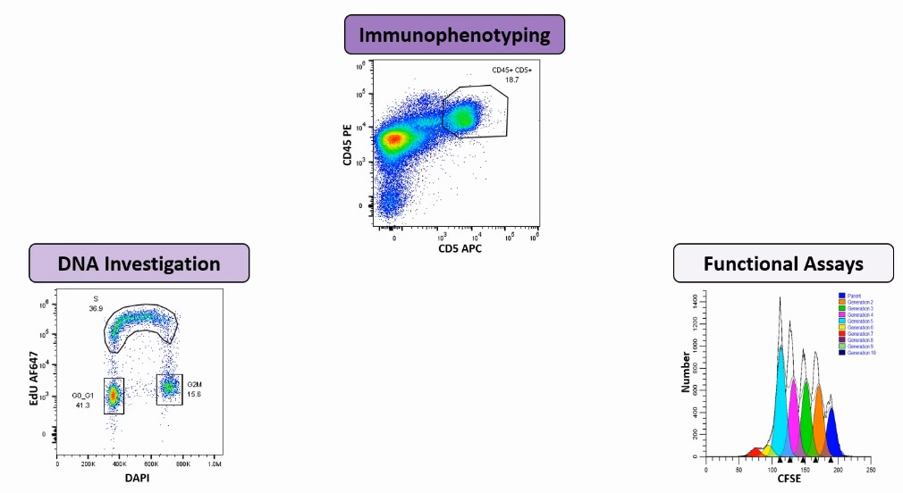
What can Flow Cytometry do?
Common applications
Immunophenotyping
DNA investigation
Functional assays

Slide 10

What is inside of the box?
Detection System
There are three main components to the flow cytometer:
The Fluidics System – Presentation of the sample to the laser.
The Optical System – Gathering information from the scattered light of the analysis.
The Computer/Electronic System – Conversion of optical to digital signals for display
Laser beam
Analysis
Flow cell
Sheath Tank
Waste Tank
Notes:
A flow cytometer’s inner workings can be separated into 3 components, fluidics, optics and electronics.

Slide 11
What is inside of the box?
Fluidic system
Altering the rate at which the cell suspension is injected into the center of the sheath fluid will have a direct effect on the width of the sample stream and the number of cells passing through the interrogation point.
Flow cell
variable
Pressure line
Constant
Sheath Tank
Waste Tank

Slide 12
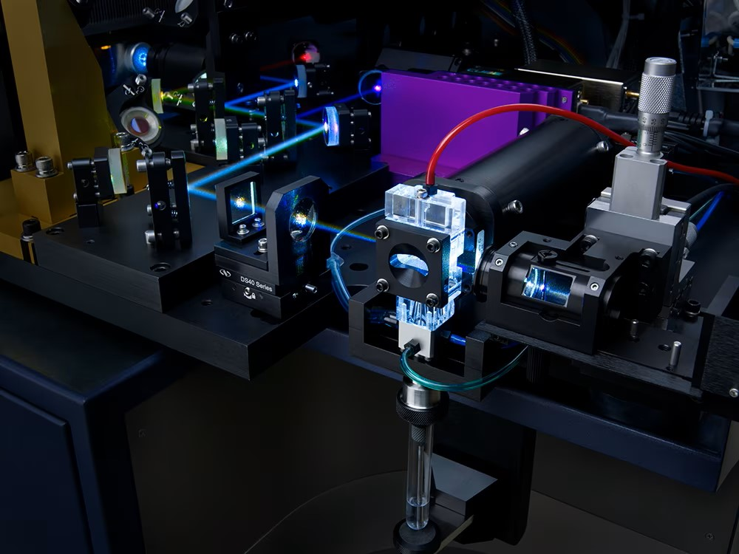


What is inside of the box?
Fluidic system
Laser beam
The Flow Cell
In order to get information about each cell individually, we need cells to pass the interrogation point one at a time.
The hydrodynamic focusing within the flow cell aligns the cells in single line.
Flow cell

Slide 13
What is inside of the box?
Fluidic system
Low sample pressure
low flow rate
High sample pressure
high flow rate
The higher the sample pressure the wider the coaxial stream, resulting in more cells passing the interrogation point in a less than optimal position.
By lowering the sample pressure this narrows the coaxial stream, resulting in cells passing the interrogation point in single file
Results in unequal illumination of cells and increase in coincidence
Laser beam
Laser beam

Slide 14
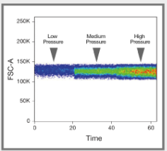
What is inside of the box?
Fluidic system
250k
The higher the sample pressure the wider the coaxial stream, resulting in more cells passing the interrogation point in a less than optimal position.
By lowering the sample pressure this narrows the coaxial stream, resulting in cells passing the interrogation point in single file
Results in unequal illumination of cells and increase in coincidence
200k
Low pressure
Medium pressure
High pressure
150k
FSC-A
100k
50k
0
0
20
40
60
Time

Slide 15
What is inside of the box?
Optical system
Array of detectors and filters
530/15
488/10
Array of lasers
505/42
Schematic layout of the optical bench in the flow cytometer.
661/16
670 LP
640nm
488/10
Forward Scatter diode
488nm
Flow cell
variable
Pressure line
Constant
Sheath Tank
Waste Tank

Slide 16
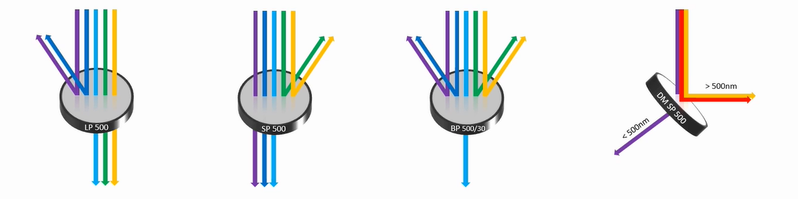
What is inside of the box?
Optical system
Optical filters in flow cytometers
Long pass
Short pass
Band pass
Dichroic mirrors

Slide 17
What is inside of the box?
Optical system
Example of the optical bench in the LSR Fortessa flow cytometer.

Slide 18
What is inside of the box?
Optical system
Side Scatter Detector
Light scatter
Simple illustration of forward and side light scatter properties of a cell
Light source
Forward Scatter Detector

Slide 19
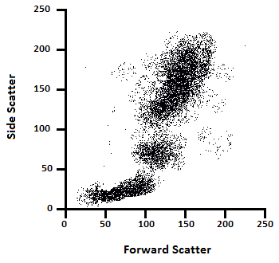
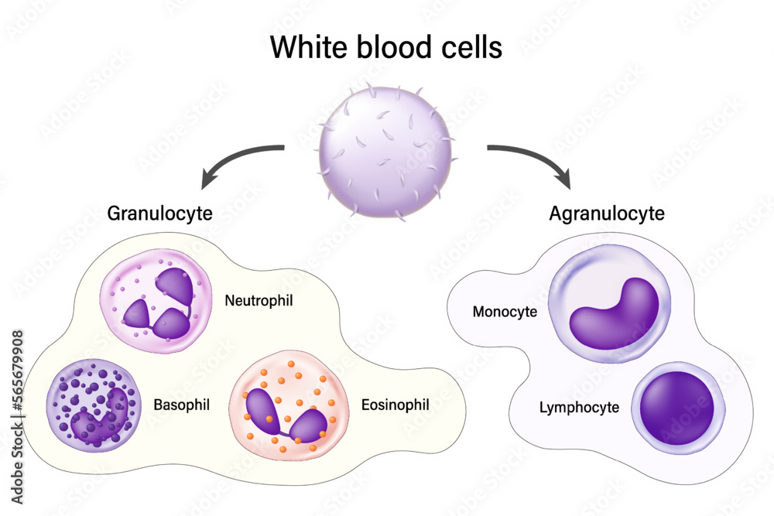
What is inside of the box?
Optical system
Light scatter
Simple illustration of forward and side light scatter properties of a cell
Granulocytes
Monocytes
Lymphocytes
Practical Flow Cytometry in Haematology Diagnosis, First Edition. Mike Leach, Mark Drummond and Allyson Doig. © 2013 John Wiley & Sons, Ltd. Published 2013 by John Wiley & Sons, Ltd.

Slide 20
What is inside of the box?
Optical system
Higher Energy and vibration states
Fluorescence
Lowest Singlet Excited state
Absorption
Loss of Energy

Slide 21
What is inside of the box?
Optical system
Stokes Shift
FITC
(Fluorescein-5-isothiocyanate)
Stokes Shift is 24 nm
495 nm
519 nm
Fluorescence Intensity
Excitation spectrum
Emission spectrum
Wavelength

Slide 22
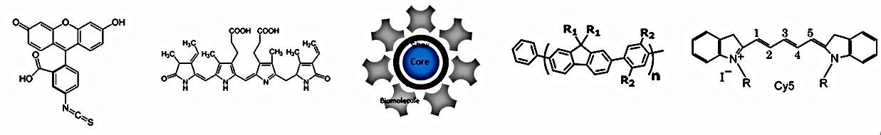
What is inside of the box?
Optical system
Classes of fluorochromes
Small organic dyes
Large Protein Based Molecules
Inorganic Fluorescent Nanocrystals
Organic Polymers
Synthetic Dyes
e.g., FITC
e.g., PE, APC
e.g., Qdot
e.g., Briliant
e.g., Cy5

Slide 23
What is inside of the box?
Optical system
Fluorescence intensity
10⁵
10⁵
MFI population A
10⁵
Mean Fluorescence Intensity (MFI)
10⁴
10⁴
MFI population B
10⁴
MFI
CD 20
CD 20
CD 20
10³
10³
10³
Heterogenous expression
Homogenous expression
CD 2
CD 2
CD 2
Deriving a CD20+ MFI value for a B-cell population in blood.
Differences in CD20 MFI values for two different B-cell populations in blood can assist in diagnosis.
Spectrum of fluorescence intensity. Although the MFI is the same for the two populations, the variation in intensity is different.

Slide 24
What is inside of the box?
Optical system
Spectral overlap
Fluorescein isothiocyanate (FITC)
Phycoerythrin (PE)
In order to ensure accuracy, compensation has to be applied to subtract the overlapping signals. The high wavelength emissions from FITC will be captured by the PE detector and vice versa. If compensation is not applied, then inappropriate dual positive events (Q2) will be captured.
488 nm
The FITC overlaps into PE channel. The overlap is proportional to FITC intensity.
Fluorescence Intensity
Wavelength
The emission wavelengths of FITC and PE overlap

Slide 25
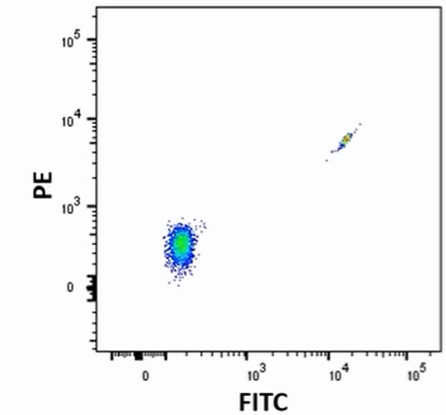
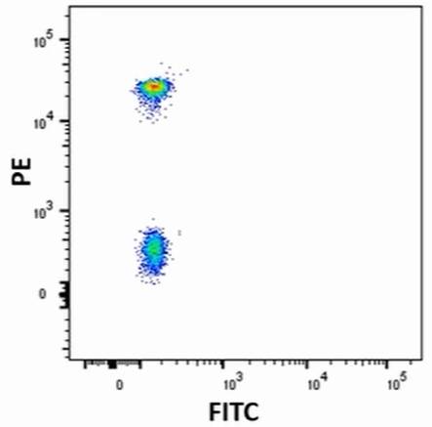
What is inside of the box?
Optical system
Spectral overlap - compensation
FITC single-stained control
PE single-stained control
Single-stained control
Beads
Cells
As brighter as a sample
Match sample fluorochromes
Identical background fluorescence for +/-
On scale and in PMT linear range
Median intensities not matching
Compensation needed
Median intensities matching
No compensation needed
WORK-FLOW 2019

Slide 26
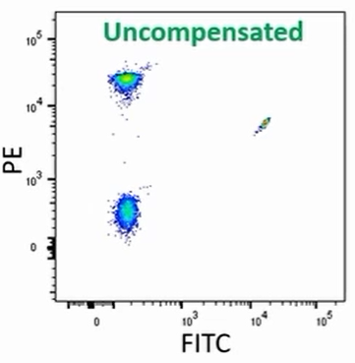
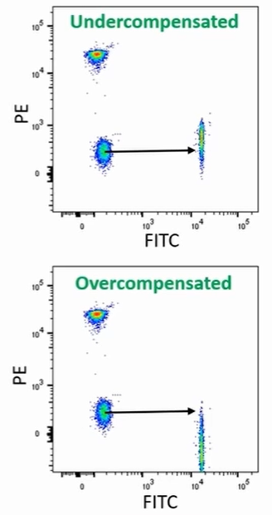
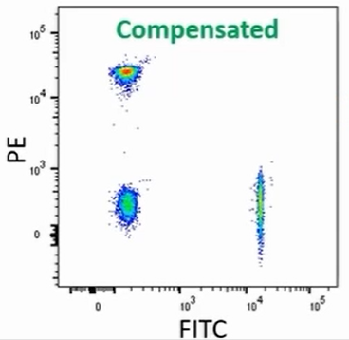
What is inside of the box?
Optical system
Spectral overlap - compensation
Compensation matrix
 | FITC | PE
FITC | 100 | 31.57
PE | 0 | 100
WORK-FLOW 2019

Slide 27
What is inside of the box?
Optical system
Spectral overlap - compensation
Q1
Q2
Schematic diagram illustrates that the mean fluorescence intensity (MFI) for each fluorochrome should be equivalent for both positive and negative events so compensating for spectral overlap.
Phycoerythrin (PE)
Q3
Q4
Fluorescein isothiocyanate (FITC)
Compensation for spectral overlap of fluorochromes

Slide 28
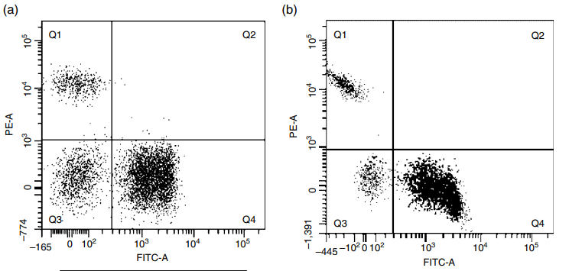
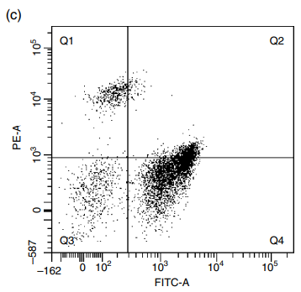
What is inside of the box?
Optical system
Spectral overlap - compensation
Population | FITC – A Mean | PE-A Mean
Q1 | 49 | 12785
Q2 | 1398 | 5326
Q3 | 51 | 173
Q4 | 1785 | 178
Population | FITC – A Mean | PE-A Mean
Q1 | -202 | 12785
Q2 | 1598 | 1526
Q3 | 51 | 217
Q4 | 1895 | -110
Population | FITC – A Mean | PE-A Mean
Q1 | 164 | 12785
Q2 | 2798 | 2526
Q3 | 64 | 238
Q4 | 1650 | 457
Practical Flow Cytometry in Haematology Diagnosis, First Edition. Mike Leach, Mark Drummond and Allyson Doig. © 2013 John Wiley & Sons, Ltd. Published 2013 by John Wiley & Sons, Ltd.
Notes:
Compensation for spectral overlap of fluorochromes: illustrating a worked example.
Correct compensation Accurate compensation allows for spectral overlap and generates discrete cell populations with equivalent MFI for both FITC (green values) and PE (red values) channels.
(b) Overcompensation This encourages populations to be pulled down the axis for the relevant fluorochrome – too much subtraction collapses/skews the events downward and the MFI values are different. If this is not corrected dual positive population may be missed.
(c) Under compensation This encourages populations to be pulled up the axis for the opposing fluorochrome – too little subtraction collapses/skews the events upward and the MFI values are different. This may lead to false dual positivity being reported.

Slide 29
What is inside of the box?
Optical system
Spectral overlap
Count
Count
Count
Fluorescent intensity (log)
Fluorescent intensity (log)
Fluorescent intensity (log)
Group 1
Group 2
Group 3
Lineage markers
Subpopulation markers
Activation and cytokines markers

Slide 30
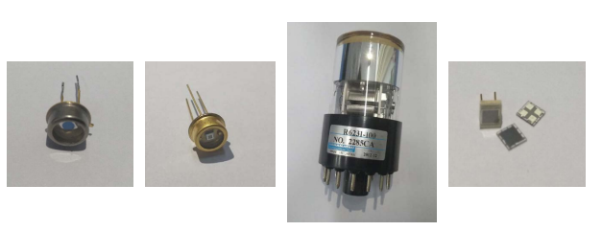
What is inside of the box?
Electronic system
Types of detectors used in different instruments
Photodiodes (PDs)
Avalanche Photodiodes (APDs)
Photomultiplier Tubes (PMTs)
Silicon Photomultipliers (SiPMs)
Detectors convert photons of light into electric current | In general, we use photodiodes (PD) for forward scatter and absorption and Photomultiplier Tubes (PMTs) for fluorescence and side scatter | There are now some instruments using Avalanche Photodiodes (APDs) instead of PMTs

Slide 31
What is inside of the box?
Electronic system
Types of detectors used in different instruments
Photodiodes (PDs)
Avalanche Photodiodes (APDs)
Photomultiplier Tubes (PMTs)
Silicon Photomultipliers (SiPMs)
e.g., BD platforms
e.g.,Cytek Auroras
e.g., BD platforms
e.g., the NovoCyte Quanteon from Agilent

Slide 32
What is inside of the box?
Electronic system
Types of detectors used in different instruments
 | PMT | APD | SiPM
Range (nm) | 300-800 | 400-1000+ | 400-1000+
Internal Gain | 10^5-7 | 10^2 | 10^5-7
Power Draw | Up to 1000V | 100-200V | Less than 100V
Dynamic Range | 5 Decades (Fortessa) | 6.5 Decades (Aurora) | 7.2 Decades (Quanteon)
Low Light Detection | Large active area and very rare dark counts | Smaller active area, more common dark counts (vs PMT) increasing with temperature | Array of microcells increases active area, more common dark counts (vs PMT) increasing with temperature
Noise | Relatively low until the ~800nm mark, increases with voltage and higher emission wavelengths | Noisier than PMT except at ~800nm+, but comparable over whole range | Noisier than PMT except at ~800nm+, but comparable over whole range
https://voices.uchicago.edu/ucflow/2021/11/22/sipm-vs-pmt-a-photon-finish/

Slide 33
What is inside of the box?
Electronic system
How the PMT works
① Light strikes the photocathode
② An electron is discharged towards a dynode
③ Electrons are ejected with each electron hitting a dynode
④ Electrons reaching the photoanode produce the photocurrent
Incoming Photon (1)
Dynodes (3)
Cathode (2)
Anode (4)
Photocurrent

Slide 34
What is inside of the box?
Electronic system
The Voltage Pulse
Laser beam
voltage
The electronic system of the flow cytometer allows the light signals to be converted into numerical data for analysis.
As light hits the photodetectors, the incoming photons are converted to electrons, resulting in a current.
This current passes through an amplifier and a voltage pulse is generated that is proportional to the number of photons detected.
The voltage pulse is created as soon as a cell or particle passes through the laser beam, with its highest point achieved when the cell or particle is in the center of the beam
time
Laser beam
voltage
time
Laser beam
voltage
time

Slide 35
What is inside of the box?
Electronic system
Spatially separated
Laser delay
To discriminate emission from specific excitation sources, lasers can be spatially separated. To combine the signals emitted by the cell or event when passing through the lasers, the laser delays, measured in
The distance between laser interrogation points is fixed, and so the particle travel time between each laser needs to be consistent.
The electronics that read signals from each laser interrogation point are calibrated to activate at fixed times
561nm
54 (µs)
Detector path laser 1
Array of lasers
640nm
32 (µs)
Detector path laser 2
405nm
28 (µs)
Detector path laser 3
488nm
0 (reference)
Detector path laser 4
Time
Multi-laser instruments:
Increase the number of usable markers
Reduce the amount of spillover between some combination of fluorophores

Slide 36
What is inside of the box?
Electronic system
Time delay Correction
Spatially separated lasers
561nm
54 (µs)
Detector path laser 1
640nm
32 (µs)
Detector path laser 2
Time delay
405nm
28 (µs)
Detector path laser 3
488nm
0 (reference)
Detector path laser 4
Time
Time

Slide 37
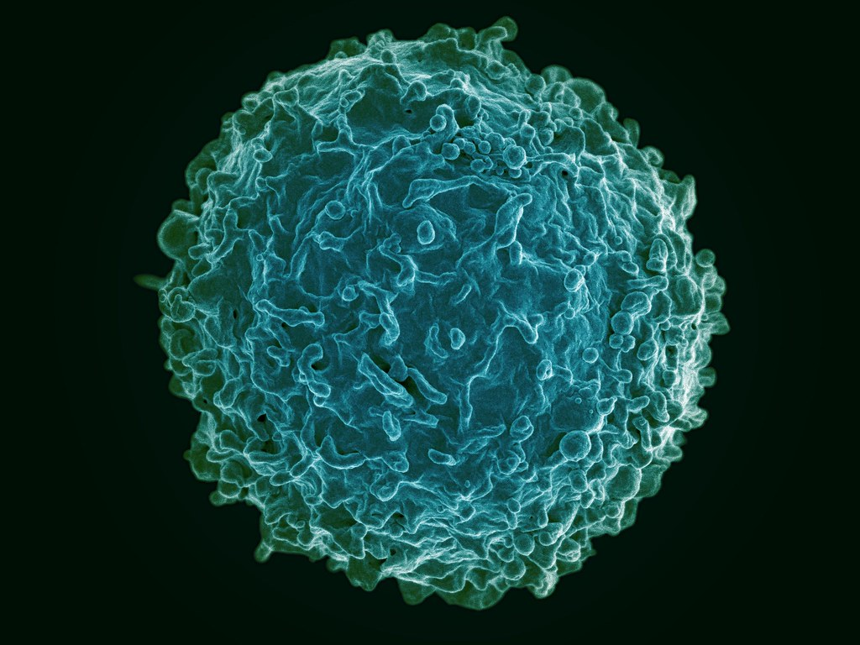
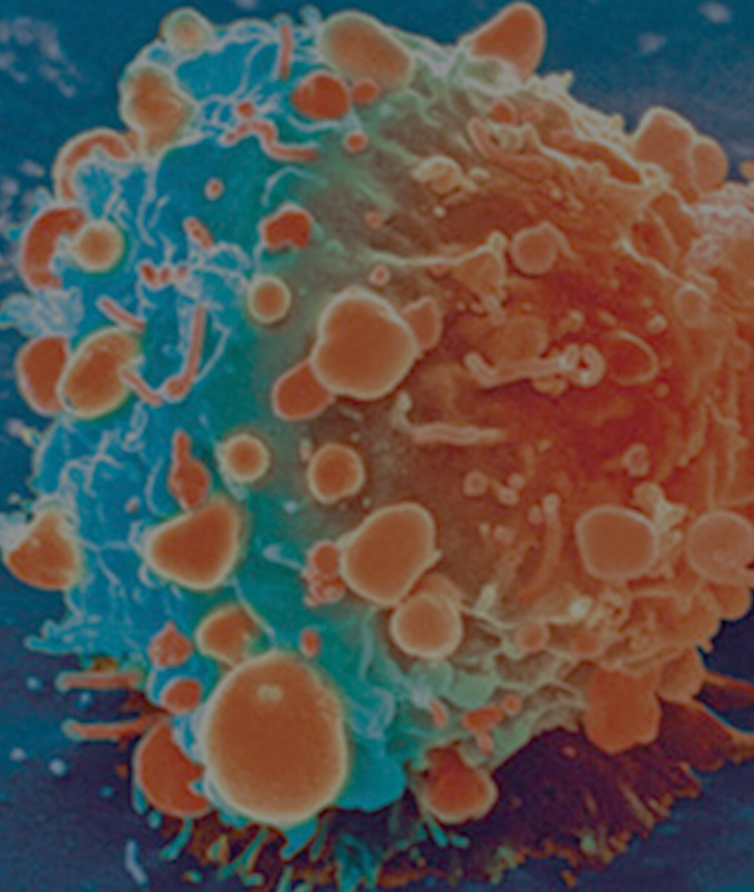
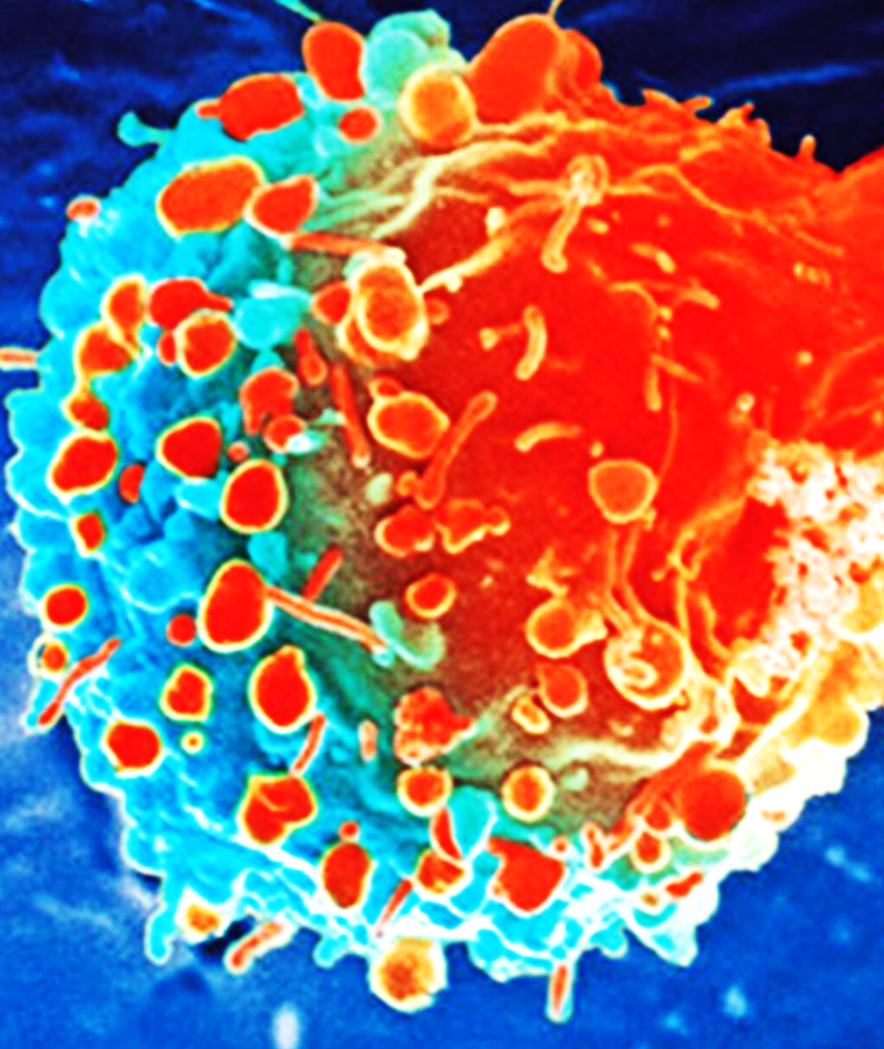
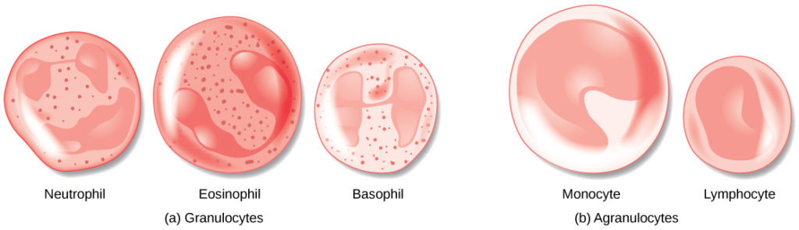


What is inside of the box?
Electronic system
The Voltage Pulse
FSC
Small cell
Fluorescence
voltage
Large cell
Low expression
Area
Hight
High expression
SSC
time
Width
Low complexity
High complexity

Slide 38
What is inside of the box?
Electronic system
The Voltage Pulse
SSC
Granulocytes
Low complexity
Monocytes
High complexity
Lymphocytes
FSC
Side Scatter Detector
Small cell
Light source
Forward Scatter Detector
Large cell

Slide 39
What is inside of the box?
Electronic system
Threshold
Whenever a particle or cell passes through the laser beam a voltage pulse is generated. To prevent interference from background noise or debris, a threshold can be set.
By setting a threshold signal value, processing only occurs when a voltage pulse signal is above this limit. Signals below threshold are not processed.
It is important to set the threshold limit so that the highest numbers of cells of interest are detected: if the threshold limit is set too low or too high there is the risk that cells of interest are missed.
voltage
threshold
time

Slide 40
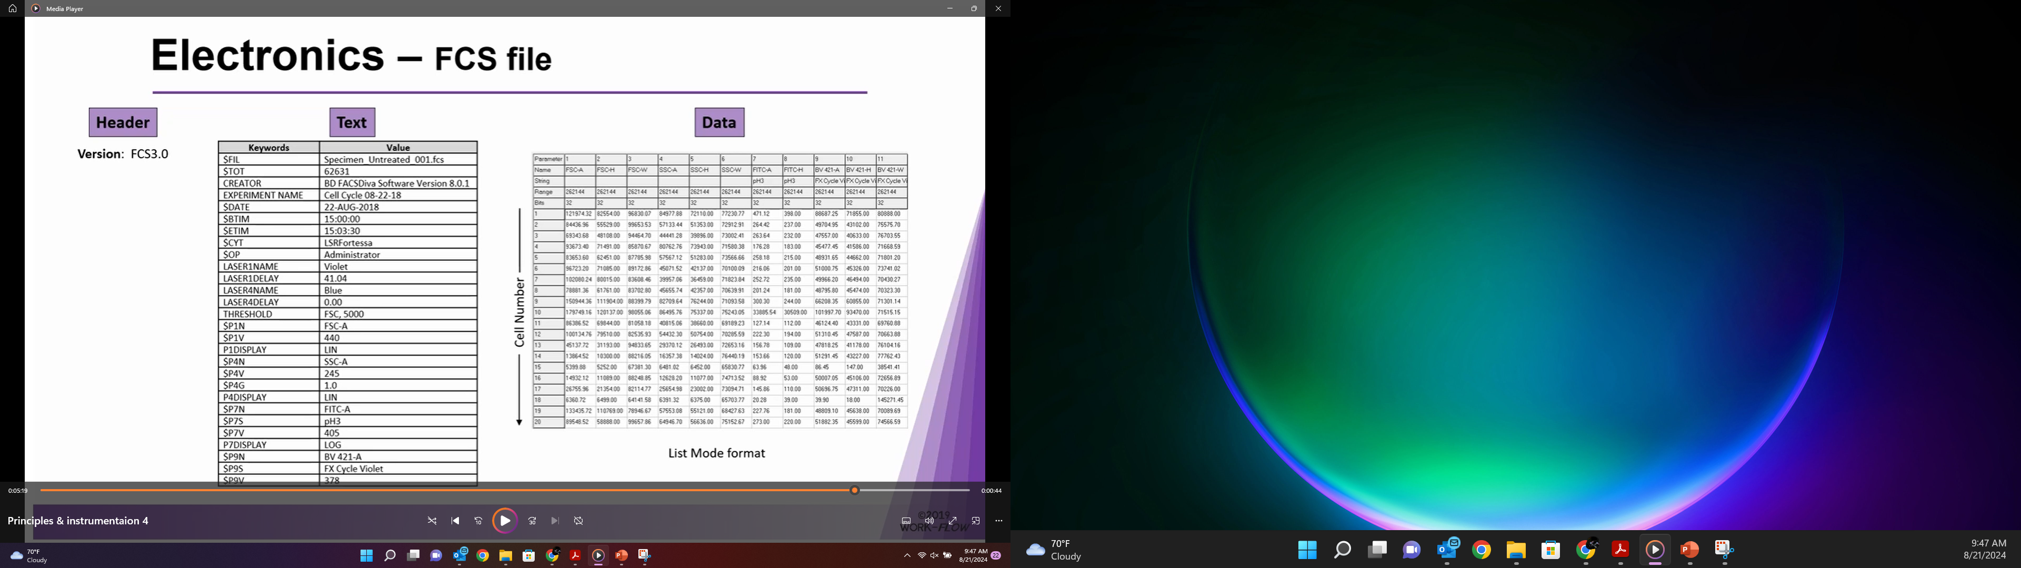
Data Display
Flow Cytometry Data Files
Header
Text
Data
Version: FCS 3.0

Slide 41
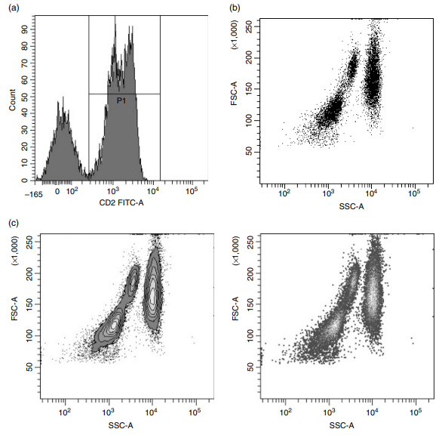
Data Display
Data presentation
Histogram
The histogram represents a single dimension and is used for displaying a single parameter.
The Y axis shows the number of events counted and the X axis shows the fluorescence intensity in Figure (a).
Dot plot
The dot plot is used to display two parameters where each dot represents a cell/particle.
The stronger the signal the further along each scale the data is displayed.
The forward versus side scatter plot is a frequently used dot plot for peripheral blood analysis and subsequent gating as in Figure(b).
Practical Flow Cytometry in Haematology Diagnosis, First Edition. Mike Leach, Mark Drummond and Allyson Doig. © 2013 John Wiley & Sons, Ltd. Published 2013 by John Wiley & Sons, Ltd.

Slide 42
THANK YOU
Cytometry and Microscopy to Omics Facility
Carver Biotechnology Center
University of Illinois, Urbana-Champaign, 2024

